Slide 1
Automate the w*rk out of everything

Slide 2

Industry and partner solution marketing
Brent Haley
STORY TELLER & CONTENT STRATEGIST

Slide 3
Discussion
01 Workato in Industries
02 Industry Framework
03 Content BOM
04 Scaling with Partners

Slide 4
Top industries
Providing a platform with proven solutions for industry problems delivered through an ecosystem.
Financial Services
(Banking & Insurance)
Manufacturing & Supply Chain
Healthcare &
Life Sciences
~ $12-15B TAM
~ $8-10B TAM
~ $5-8B TAM
~24%
of global RPA revenue
~18%
of global RPA revenue
~20%
of global RPA revenue
Notes:
Industry Prioritization Framework
Selection Criteria: To determine the top 3 focus industries for the next 12–18 months, we evaluate each candidate industry against a clear framework of criteria. These include market size, automation maturity, partner ecosystem strength, and Workato fit. Each criterion ensures we choose verticals with significant revenue opportunity (large market, high demand for automation), readiness for integration/automation solutions (mature processes ripe for automation), strong partner alignment (consultancies or ISVs active in the space), and a natural alignment with Workato’s platform capabilities and success stories.
Automation Maturity: Industries at higher automation maturity (or rapidly maturing) can more quickly leverage Workato. For example, banking leads in workflow automation adoption with nearly 24% of the marketmordorintelligence.com, indicating openness to integration and RPA solutions. Meanwhile, sectors like healthcare are traditionally less automated but now accelerating (11.4% CAGR in automation spend)mordorintelligence.com, suggesting a growing need we can tap into.
TAM (Market Opportunity): We sized the potential by looking at IT spending and number of enterprises in each sector. Financial Services and Manufacturing have massive global IT budgets and thousands of large enterprises, making for a big TAM. Healthcare/Life Sciences and Retail are also huge markets undergoing digital transformation. We favor industries where automation can address costly inefficiencies (e.g. high transaction volumes in banking, complex supply chains in manufacturing) for significant ROI.
Partner Strength: We considered where our Global Systems Integrators (GSIs) and technology partners have deep expertise. Sectors like Financial Services, Life Sciences, and Retail are specifically highlighted in our Deloitte alliancedeloitte.com, and GSIs like Accenture and PwC have sizable practices in Banking, Manufacturing, Healthcare, etc. A strong partner presence means ready allies to co-develop solutions and credibility in those markets.
Use Case Alignment: We mapped each industry’s common workflows to Workato’s proven enterprise automation use cases (e.g. sales lead management, quote-to-cash, employee onboarding, IT ops, data pipeline automation). Prioritized industries have clear pain points that Workato can solve – for instance, banks need faster customer onboarding (a strength of Workato’s integration workflows), and manufacturers need to connect disparate systems (core iPaaS capability). Industries where Workato’s existing “recipes” and connectors already address typical applications got a higher score
Each industry’s TAM reflects spending on enterprise automation, integration, and orchestration platforms (e.g. RPA, iPaaS, workflow automation, API integration). Financial services leads in total spend, while healthcare is seeing the quickest growth. Manufacturing (including supply chain automation) also represents a significant opportunity, leveraging automation for operational efficiency. Sources: Gartner/Mordor Intelligence market share estimates and industry reports
Financial Services (Banking & Insurance)~$12–15 billion (est. 2024)Largest vertical in enterprise automation. BFSI accounted for ~30% of intelligent automation software spend in 2024mordorintelligence.com. For example, the BFSI sector’s RPA spend alone was about $8.3B in 2024precedenceresearch.com. Strong adoption is driven by use cases in regulatory reporting, customer onboarding, and fraud detection.mordorintelligence.comprecedenceresearch.com
Manufacturing (incl. Supply Chain)~$8–10 billion (est. 2024)Major adopter of automation and integration tech, e.g. ~18% of global RPA revenue (≈$4.2B in 2024) came from manufacturingprecedenceresearch.com. Automation platforms are widely used to streamline production, quality control, and supply chain processes. Industry 4.0 initiatives and hyperautomation are firmly on manufacturing boardroom agendasmordorintelligence.com, driving steady growth (high single-digit to low double-digit CAGR).precedenceresearch.commordorintelligence.com
Healthcare & Life Sciences~$5–8 billion (est. 2024)Fastest-growing vertical in enterprise automation. Healthcare/Life Sciences made up ~20% of RPA spend (~$4.8B in 2024)precedenceresearch.com and are adopting workflow automation for patient data, claims processing, and R&D. Projected to expand at ~25% CAGR as organizations automate patient workflows and compliance tasksmordorintelligence.com. This sector’s automation investments are accelerating to improve efficiency and outcomes.
-------------------------------------------------

Slide 5
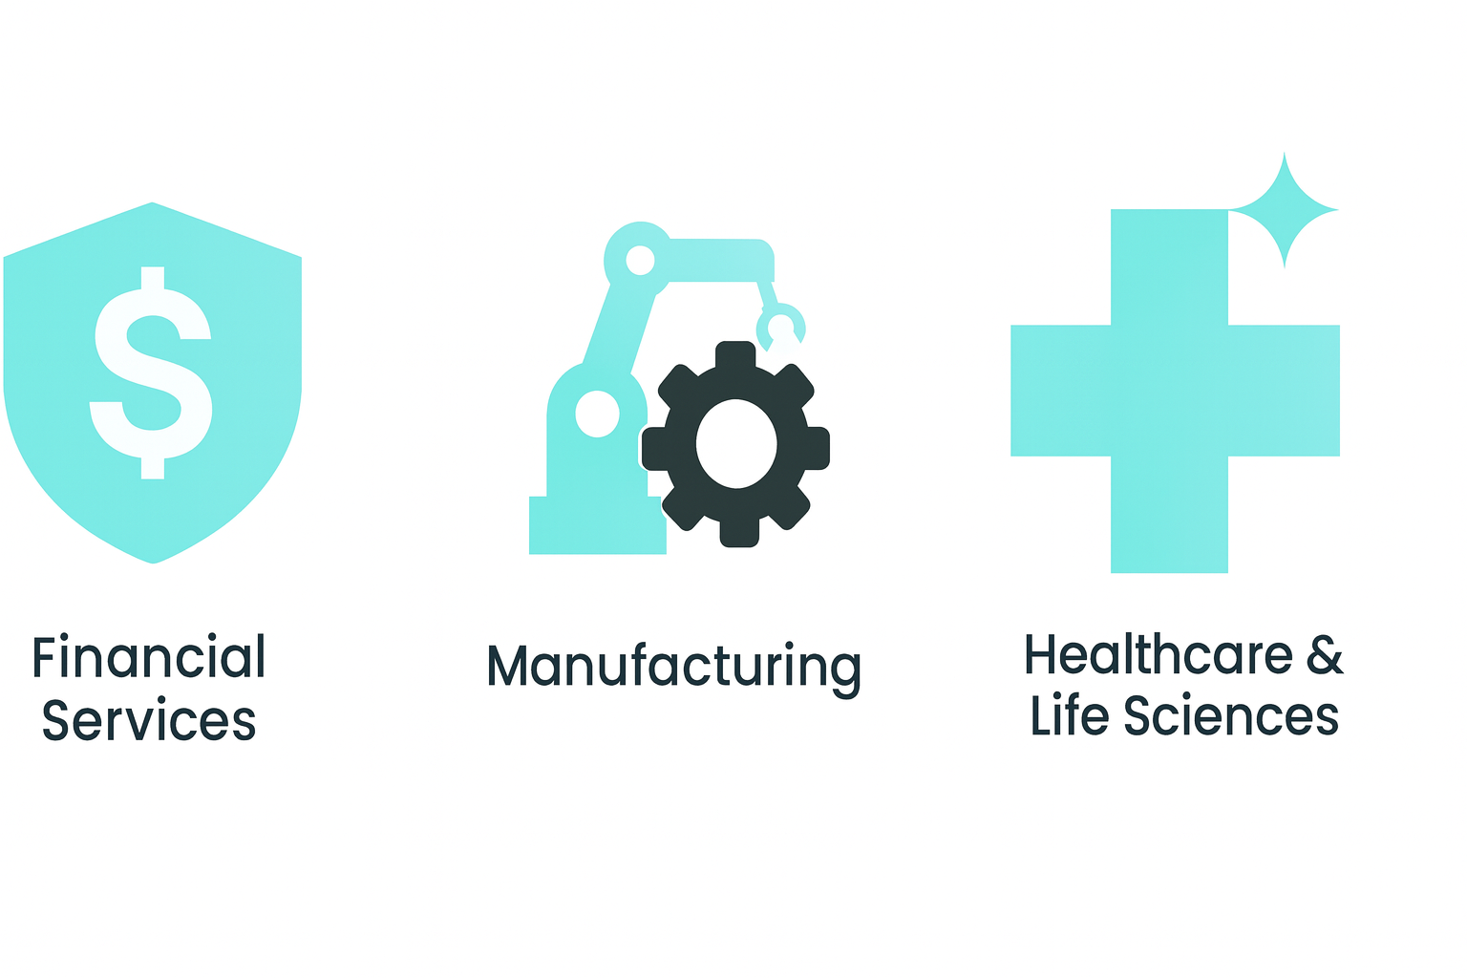
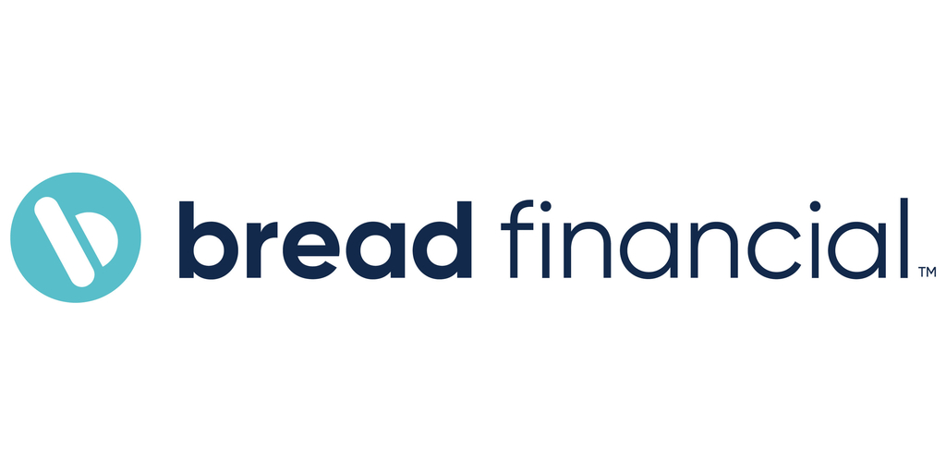
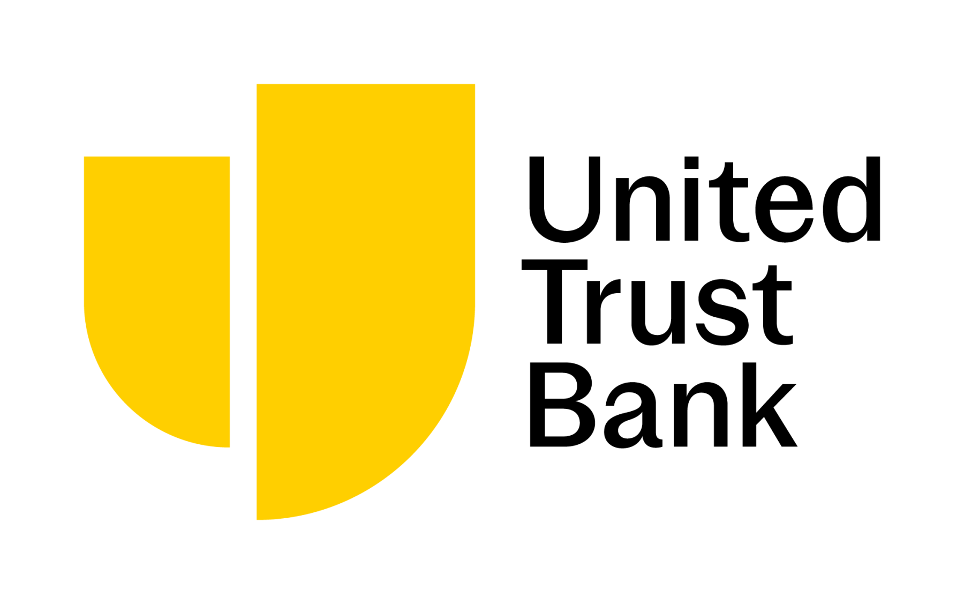
Financial Services (Banking & Insurance)
24% share of the workflow automation market
Huge potential for operational & IT cost reduction
Prime for AI & orchestration
Notes:
Financial Services (Banking & Insurance)
Rationale: Financial Services is a clear front-runner for Workato. Banks and insurers are highly automation-aware – they currently represent about a 24% share of the workflow automation market (the single largest of any sector)mordorintelligence.com. They have enormous IT spending and pressure to modernize legacy systems, giving Workato a large TAM. Critically, finance organizations handle huge volumes of data and transactions under strict compliance requirements – an ideal scenario for integration and workflow automation.
Automation Maturity: Banks have led in adopting RPA and integration platforms. Many have already done tactical automations (like RPA bots for data entry) and are now looking for more robust, enterprise-wide orchestration. For example, banks employ automation bots for customer due diligence and KYC checks, yielding up to 70% faster cycle times and lower error rates than manual processingmordorintelligence.com. This maturity means less education needed – they understand the value of a unified platform.
Use Case Alignment: Workato’s core use cases map strongly here. Customer onboarding/KYC, loan application processing, payment processing, and compliance reporting are critical processes that demand integration of multiple apps (core banking, CRM, credit bureaus, etc.). Workato can streamline these end-to-end. For instance, the fintech Bread Financial used Workato to integrate online credit card applications with Salesforce and internal databases, cutting application processing from ~30 minutes to just a few minutesworkato.com. Similarly, AvidXchange uses Workato as middleware between its application portal and Salesforce to automate customer and supplier onboardingworkato.com. These successes show Workato delivering the fast, error-free processing that banks need to stay competitive.
Partner Ecosystem: GSIs have deep financial services practices – Deloitte, Accenture, PwC all advise banks/insurers on digital transformation. In fact, Deloitte was recognized as Workato’s strategic partner of the year and has been co-developing industry-specific orchestration use cases for financedeloitte.comworkato.com. By prioritizing FS, we can leverage these partners’ domain knowledge and client relationships. Joint solutions (e.g. automating mortgage processing, or claims in insurance) will resonate given partners’ credibility.
Market Momentum: Industry trends like fintech disruption, open banking APIs, and stricter regulations are forcing banks to integrate systems and automate manual workflows. Automation maturity is high but so are the stakes – nearly 98% of finance teams have invested in some process automation solvexia.com, yet most have only automated a fraction of their processessolvexia.com. This gap presents an opportunity: Workato can help FS organizations go from isolated bots to end-to-end automation, addressing both front-office needs (customer experience) and back-office efficiency (compliance, finance ops). Given the strong ROI – e.g. one Workato customer in banking saw a 40% reduction in IT operational costs through automationworkato.com – we expect quick wins that can be publicized as proof points.

Slide 6
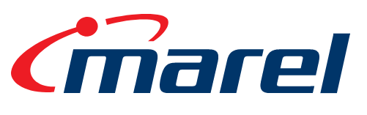
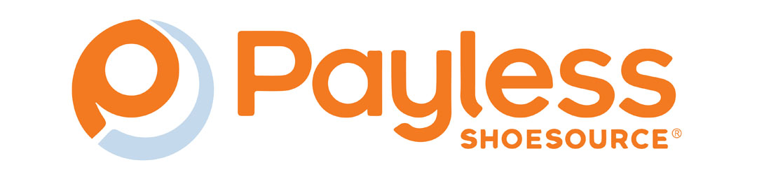
Manufacturing & Supply Chain
Huge budgeted IT spend for industry digital transformation
Legacy systems, that are siloed and need integration
Massive manual data handling across MES, ERP & procurement.
Notes:
Manufacturing & Supply Chain
Rationale: Manufacturing (including supply chain and logistics) is a vast sector undergoing rapid digital transformation (“Industry 4.0”). Manufacturers have complex legacy ERPs, shop-floor systems, IoT devices, and global supply chain networks that are often siloed – a perfect scenario for an integration and automation platform. The TAM is huge: global industrial firms spend hundreds of billions on automation and IT, and even mid-sized manufacturers need better connectivity. Partner strength is notable; firms like Accenture (through “Industry X”) and Deloitte have practices helping manufacturers modernize operations. Workato’s use cases around data integration and process orchestration align extremely well with manufacturing needs.
Automation Maturity: Historically, manufacturing focused on physical automation (robots, control systems). But enterprise process automation maturity is medium and rising – many companies still rely on manual data handling across MES, ERP, procurement, etc., but are now investing in workflow automation to stabilize supply chains and respond to demand volatilitymordorintelligence.com. As IoT adoption grows, there’s an acute need to integrate sensor data with business systems in real-time. For example, manufacturers are leveraging automation to analyze machine data and trigger maintenance or quality checks instantly at the edgemordorintelligence.com. The sector is primed for Workato to introduce low-code integration as a complement to industrial automation.
Use Case Alignment: Key processes in manufacturing/supply chain match Workato’s strengths:
Order-to-Cash and Supply Chain Integrations: Connecting CRM orders to ERP fulfillment, inventory systems, and shipping providers to automate order processing and updates.
Procure-to-Pay: Automating procurement workflows by integrating procurement apps with ERP and supplier portals.
IoT Data Orchestration: Ingesting factory sensor/IoT data and integrating with maintenance systems or analytics platforms (e.g. trigger a Workato recipe when a machine sensor flags an anomaly, to create a service ticket in ServiceNow).
Employee and Partner Onboarding: Large manufacturers onboard thousands of employees and contractors across plants – Workato can automate user account setups, training enrollment, etc., similar to HR use cases in other industries.
Real-world examples underscore the fit. Marel, a global food equipment manufacturer, uses Workato to automate internal processes (employee onboarding/offboarding, inter-company sales data sync) to ensure every system has standardized, clean data in near real timeworkato.com. This unified data flow is invaluable in a volatile supply chain environment. Another example in retail/manufacturing: Payless utilized Workato to unify its data warehouse across four different payroll systems, saving 40% in IT costs and simplifying compliance across regionsworkato.com. These cases show that integrating systems end-to-end – from R&D and production to sales, HR, and finance – yields huge efficiency gains for manufacturers.
Partner Ecosystem: Manufacturing transformation often involves big consultancies for systems integration (SAP/ERP experts, IoT specialists). Accenture in particular is a strong ally here – they have a dedicated Industry X group focusing on smart factory and supply chain automation, and they’ve been recognized as Workato’s “Best Digital Innovation Partner”workato.com. We can partner with Accenture (and others like Deloitte’s supply chain practice) to build solutions such as “Connected Factory” frameworks (e.g. integrating factory floor data with enterprise applications). Partners bring domain IP (e.g. templates for SAP integration, industry-specific compliance) that, combined with Workato’s platform, result in ready-made solutions for manufacturing clients. Given that automation in manufacturing is pivotal for shop-floor decisions and quality controlmordorintelligence.com, our joint offerings can directly address those mission-critical needs.
Market Momentum: Current trends amplify the need for Workato in this vertical. Supply chain disruptions have highlighted the importance of real-time data flow between manufacturers, suppliers, and logistics providers. Many are investing in resilience – for example, deploying automation to instantly reroute orders or update customers when delays occurmordorintelligence.com. Sustainability and compliance requirements (e.g. environmental reporting) also demand better data integration across operationsmordorintelligence.com. Furthermore, as manufacturing firms adopt more cloud apps (for PLM, asset management, etc.), the integration challenge grows. Workato’s low-code approach allows even non-IT staff (like plant operations or business analysts) to create automations under IT governance, which is a big plus in resource-constrained IT environments. By prioritizing manufacturing, Workato can position itself as the digital glue of Industry 4.0, supported by strong partner credentials in this space.

Slide 7
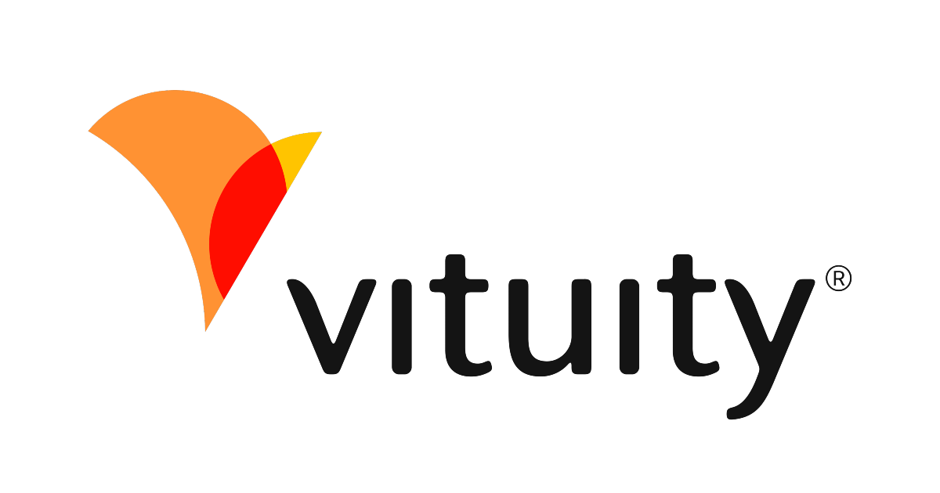

Healthcare & Life Sciences
Automation growth estimated at ~11% CAGR
Unify siloed data from fractured systems
Low code solutions needed due to lack of IT
Notes:
3. Healthcare & Life Sciences
Rationale: Healthcare (including providers, hospitals, and payers) and Life Sciences (pharmaceuticals, biotech, medical devices) form another giant industry where automation needs are now acute. While historically slower to adopt new tech due to regulations and legacy systems, healthcare is at a tipping point for digital transformation – especially post-pandemic with telehealth, staffing shortages, and the drive for efficiency. The TAM is enormous: healthcare is one of the largest global sectors by spend. Partner strength is solid, as GSIs like Deloitte and PwC have major healthcare consulting divisions (Deloitte explicitly calls out life sciences as a focus with Workatodeloitte.com). Workato’s platform can help healthcare organizations connect their fragmented systems and automate manual workflows, improving both operational efficiency and patient outcomes.
Automation Maturity: Currently moderate but rapidly growing. Healthcare organizations have begun automating administrative tasks (e.g. scheduling, billing) but many processes remain manual or paper-based. Notably, Healthcare and Pharma are projected to see the fastest automation growth (~11% CAGR) through 2030mordorintelligence.com, indicating a strong upcoming demand for solutions. We’re already seeing early signs: for instance, hospitals are experimenting with automation + AI, like analyzing unstructured clinical notes with AI to trigger care workflows (e.g. flagging sepsis risk and automating alerts)mordorintelligence.com. This suggests openness to modern automation platforms. However, many healthcare institutions lack large IT teams, so a low-code solution like Workato (with strong governance and security) is very attractive as they mature.
Use Case Alignment: There are high-impact use cases in healthcare/LifeSci where Workato excels:
Employee Onboarding & Credentialing: Hospitals and clinics face chronic staff shortages and high turnover. Automating onboarding (account setup, training, credential verification across HR and clinical systems) saves critical time. Vituity, a leading acute care provider, automated its physician onboarding with Workato and saw 20–30% faster productivity in bringing new clinicians on boardworkato.com. This directly addresses the staffing challenge by getting doctors and nurses to the bedside faster.
Patient Intake and Referrals: Integrating electronic health record (EHR) systems with scheduling, insurance, and communication tools to streamline patient admissions or referrals. For example, automating the transfer of patient data from a hospital EHR to a specialist clinic’s system could eliminate faxing and delays – Workato can securely orchestrate these data flows (with HIPAA compliance features).
Claims Processing and Billing (Healthcare Payers): Automating the hand-off between healthcare providers, insurance systems, and billing. Workato can integrate claims management software with finance and even use bots to validate claim data, reducing errors and approval times. (Notably, some healthcare providers using RPA have achieved 90% accuracy improvements in claims adjudication and reportingmordorintelligence.com – a benchmark Workato can meet or exceed with end-to-end integration).
Life Sciences Data Integration: In pharma/biotech, Workato can connect systems like clinical trial management, lab information systems, and CRMs. A use case might be automating the flow of clinical trial data from research sites to a central database and to reporting tools, ensuring faster insights and compliance with FDA reporting timelines.
Overall, Workato’s ability to unify data from fractured systems is a game-changer for healthcareworkato.com. Many providers still struggle with data trapped in different silos (EMRs, insurance portals, etc.). Workato recipes can bridge these gaps – for example, linking ambulance service data with ER admission systems to trigger pre-registrations, or syncing vaccine inventory data with state databases automatically. The result is better patient experiences and reduced admin burden on staff.
Partner Ecosystem: All major GSIs have healthcare and life sciences expertise which we can leverage. Deloitte, for instance, has a healthcare consulting arm and is already inclined to build solutions with Workato (our alliance mentions life sciences explicitly)deloitte.com. A partnership might involve creating templates for, say, “Connected Hospital Operations” or “Pharma Clinical Operations Hub” using Workato. These could include pre-built integrations (e.g. Workato connectors for Epic or Cerner EHRs, Veeva Vault for pharma, etc.) accompanied by Deloitte’s process blueprints. By focusing on this industry, we also tap into specialized tech partners (like EHR vendors, or healthcare ISVs) that can extend our platform’s reach. The credibility of a partner is key in this conservative sector – having, say, PwC or Deloitte co-create an automation playbook for healthcare finance or compliance will reassure clients about security and best practices.
Market Momentum: The timing is right: post-COVID digital health initiatives, value-based care models, and cost pressures are pushing healthcare providers to seek efficiency through automation. Additionally, life sciences companies are adopting digital workflows for R&D and supply chain (e.g. automating drug safety reporting, connecting manufacturing data for FDA compliance). Workato can ride this wave by providing an enterprise-grade, secure automation platform that both IT and medical operations teams can use. Early success stories (like Vituity) show that even a 20% productivity gain in a process can translate to faster patient serviceworkato.com – exactly the kind of impact healthcare executives are looking for. With focused messaging (e.g. how Workato helps “do more with less” amid staff shortages) and partner-backed solutions, we can rapidly build momentum in this vertical.

Slide 8
Industry development framework
02
Notes:
By standardizing the BoM across industries, we also create efficiency – the company isn’t reinventing the wheel for each new vertical. We use a scalable approach: pick an industry, plug it into the BoM framework, and quickly generate the needed positioning and materials. This approach is validated by market leaders – research notes that top automation vendors defend market share by developing vertical-specific templates and solutions. Workato will do the same, establishing an “industry playbook” that can be executed repeatedly, leading to faster growth in each new vertical we prioritize.

Slide 9
Framework for industry development
Subject matter expertise or focus
Customer Advisory
Direct: Product Marketing and GTM consulting
Partner campaigns
Develop Strong POV & vision
Current domain use cases that can be applicable to industry for ROI today
Broadening solution use cases
Orchestration across larger processes
GTM Knowledge / use case depth
0
6
12
18
months
Notes:
Strategic Note – Execution Overlay: Industry selection is not just a strategic analysis exercise; it must be grounded in go-to-market execution realities. Even if an industry looks attractive on paper, Workato’s ability to succeed in that vertical hinges on having the right enablement in place. In practice, customers in target industries expect to engage with field-facing subject matter experts (SMEs) who truly understand their domain. These SMEs are essential to work closely with customers, shape industry-specific messaging, and pinpoint high-value use cases – ultimately building credibility. (In fact, in vertical SaaS, buyers often demand to talk to a domain expert; generic reps without domain knowledge “often literally close nothing”saastr.com.)
Additionally, success requires product-fluent marketers or solution consultants who can translate that industry expertise into repeatable, scalable solutions on Workato’s core automation platform. This means having team members capable of rapidly building and packaging industry-specific “recipes” and integration templates that can be reused across multiple clients. (For example, effective Workato enablement involves developing reusable connectors and automation templates for common workflowssoftserveinc.com, much like Workato’s own pre-packaged accelerators for common use casesworkato.com.) These product-savvy specialists ensure that for each chosen vertical, we can deliver pre-built solutions and reference architectures that demonstrate fast time-to-value.
Why This Matters: This execution context is a crucial success factor overlaying the selection criteria above. We should validate that we have (or can develop) the necessary GTM enablement resources – the domain-expert field teams and solution-building capacity – before finalizing our industry priorities. In other words, choosing an industry isn’t just about market attractiveness; it also means investing in expertise and assets to serve that industry. By overlaying this execution readiness lens on our decision framework, we ensure Workato not only picks the right industries in theory but can also execute and win in those industries in practice. This alignment of strategic focus with on-the-ground capabilities will set each chosen vertical up for success, accelerating our industry penetration and customer value realization.

Slide 10
Content BoM
03
Notes:
By standardizing the BoM across industries, we also create efficiency – the company isn’t reinventing the wheel for each new vertical. We use a scalable approach: pick an industry, plug it into the BoM framework, and quickly generate the needed positioning and materials. This approach is validated by market leaders – research notes that top automation vendors defend market share by developing vertical-specific templates and solutions. Workato will do the same, establishing an “industry playbook” that can be executed repeatedly, leading to faster growth in each new vertical we prioritize.

Slide 11
Standardized content BoM per Industry focus
Enablement
Customer journey
Customer stories
Analyst / Market substantiation
‘How it is done’ whitepaper or webinar
Storybook / Messaging guide
CFD (slides w/ story)
Competitive battlecard
FAQs document
Demos
  explanation
  use case
Notes:
Basic enablement
Storybook / Messaging guide — short narrative + differentiated value proposition; includes persona pain points, before/after, and talk tracks.
CFD (slides w/ story) — a concise, customer-facing deck that follows the Storybook arc; intro → problem → solution → proof → next steps.
Competitive battlecard — who we face, when we win/lose, traps to set/avoid, landmine map, and “why Workato” proof points.
FAQs document — 1–2 page objection handling (security, scale, governance, TCO, build vs. buy, iPaaS vs. RPA vs. iPaaS+AI).
Demo — reproducible, 6–8 minute narrative demo with a click-by-click script, data pack, and reset instructions.
Basic customer journey
Customer story — 1-page and 3-slide versions; problem, approach, quantified outcomes, architecture, and quote.
Analyst / Market substantiation — 1–2 pages of market stats and third-party validation that size the pain and confirm urgency.
“How it is done” whitepaper (PM/PMK) — blueprint doc: reference architecture, integrations, governance, KPIs, rollout plan, and day-0/30/90 play.

Slide 12
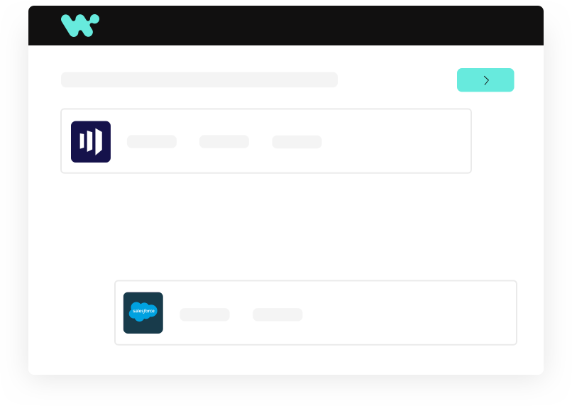
Atomizing for GTM campaigs
ebooks
Infographics
Social videos / posts
Blogs
etc
Whitepaper / Tech How To
Webinar
Customer story
Lead Generator Content
Notes:
Atomizing the big customer facing content that was developed by SMEs, has our main vision and product truth.
Taking those and

Slide 13
Create once, leverage many places…
The beauty of our standardized BoM and industry strategy is that once we craft the content and play for one partner, it can be leveraged and adapted for others with relatively low effort:
Reusing Core Content
Extending to New Geos or Segments:
Adapting the Joint Positioning:
Joint Campaign Kit for Partners:
Consistent Metrics and Feedback: What works with who?
Notes:
Scaling Across Partners Using the BoM
The beauty of our standardized BoM and industry strategy is that once we craft the content and play for one partner, it can be leveraged and adapted for others with relatively low effort:
Reusing Core Content: The industry positioning, use cases, and even campaign theme can remain the same. For example, if we did “Accelerating Digital Banking” with Deloitte, we could run “Accelerating Digital Banking with AI and Automation” with Accenture as a co-host, perhaps emphasizing a tech angle that Accenture’s innovation lab brings. The slide content, whitepaper, etc., would be 80% identical, with just partner branding and any partner-specific assets inserted.
Adapting the Joint Positioning: Each GSI might want to highlight a slightly different strength. Deloitte might focus on compliance (their risk advisory strength), Accenture might focus on tech innovation, PwC on strategy. We can adjust the joint positioning statement to say “Workato + [Partner]” with a different last mile message. But the promise (integrated automation for banking) stays consistent. This ensures every partner play still reinforces Workato’s core value prop while letting the partner shine in their domain.
Extending to New Geos or Segments: Partners often vary by region – e.g. Deloitte might drive our FS play in North America, while perhaps a regional SI (or another Big4 like EY) might do so in APAC. Because we have a kit, we can hand it to any partner and enable them quickly. We could even conduct train-the-trainer sessions with partner teams using these materials, creating multipliers in each geography.
Joint Campaign Kit for Partners: Part of scaling is providing partners a campaign-in-a-box. We would package the slides, email templates, solution briefs, and even the webinar recording from the first event as a model. Then, partner managers at Workato can approach another partner and say, “We have this successful campaign blueprint for banking automation – would you like to run it together in your region or with your client base?” This makes it easy for partners to say yes, since much of the content is ready. It also ensures that even if multiple partners run similar campaigns, the messaging in the market remains consistent (just amplified by different voices).
Consistent Metrics and Feedback: By scaling a similar play across partners, we can compare performance (e.g. webinar A with Deloitte got 100 attendees and 10 qualified opportunities, webinar B with Accenture got slightly different results, why?). We can learn and refine the approach continuously – perhaps one partner’s audience was more interested in a specific sub-topic, which we then incorporate going forward. This continuous improvement loop is enabled by having a common structure (so we’re comparing apples to apples).
In summary, the joint GTM example with Deloitte for Financial Services demonstrates how we combine our industry BoM content with partner collaboration to create a powerful, scalable campaign. We start with one partner to refine the play, then roll it out broadly:
Use the same Industry BoM (messaging, use cases, assets).
Tailor the joint positioning slightly for each partner’s flavor.
Re-run or repurpose the campaign/event in new contexts.
Empower partners with the ready-made kits so they can execute and co-invest.
This approach not only maximizes our reach (covering more of the market through multiple partner channels) but also reinforces the Workato brand as we’re consistently in front of the target audience with a strong, unified message. It shows that Workato is not just a product but a platform for industry solutions delivered through an ecosystem – a critical perception as we scale in enterprise accounts.

Slide 14
Scaling with partners
04

Slide 15
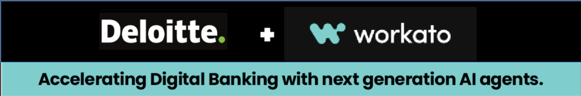
Joint Value Proposition: “Accelerate Connected Banking Operations – Deloitte and Workato empower financial institutions to orchestrate end-to-end processes, from customer onboarding to compliance, through intelligent automation. Together, we combine Deloitte’s deep industry insight with Workato’s leading integration platform to drive innovation, reduce operational costs, and enhance customer experiences in banking.”
Key Messages & Differentiators:
Industry-Tailored Solutions: Pre-built automations for common banking workflows (developed from Deloitte’s best practices, powered by Workato’s platform).
Speed and Flexibility: A low-code approach means banks can implement integrations in weeks, not months, adapting quickly to new regulations or market needs.
Compliance and Security at Scale: Emphasize enterprise-grade security (Workato’s governance) and Deloitte’s knowledge in regulatory compliance – reassuring that automated workflows will meet audit and data privacy requirements.
Joint Support and Enablement: The bank gets the “white glove” treatment – Deloitte can handle process redesign and implementation, while Workato ensures the technology success, providing a seamless path from strategy to execution.
Notes:
To illustrate how we bring the strategy to life, let’s zoom into one of the selected industries – Financial Services – and outline a joint go-to-market (GTM) play with a strategic GSI partner, Deloitte. We choose Financial Services due to its priority status and Deloitte given their strong alignment (they were Workato’s GSI Partner of the Year and have deep FS expertise). This example will show the components of a partner campaign and how it can scale to other partners using the BoM framework.
Each use case ties to an industry trend: digital customer experience, fintech competition (use case 1), instant services (use case 2), and regulatory burden (use case 3). By aligning solutions to these trends, our joint GTM messaging is very relevant. We would develop detailed solution outlines for each (possibly as part of the industry use case library in the BoM) to use in campaigns and sales talks.

Slide 16
Deloitte + Workato banking solutions
Automated Customer Onboarding & KYC Compliance
Banks are under pressure to deliver fast digital onboarding (as fintechs do) while adhering to strict Know-Your-Customer and AML regulations.
Loan Processing and Credit Decisioning Automation
Demand for quick credit (e.g. instant loan approvals, buy-now-pay-later) means banks must streamline loan origination.
Regulatory Reporting & Data Reconciliation
Financial institutions face increasing reporting mandates (e.g. GDPR, Basel III, ESG reports). Manual data gathering from siloed systems is error-prone and slow
Notes:
Automated Customer Onboarding & KYC Compliance – Trend: Banks are under pressure to deliver fast digital onboarding (as fintechs do) while adhering to strict Know-Your-Customer and AML regulations. Use Case: Workato + Deloitte automate the customer onboarding journey: when a new customer applies (via web or mobile), Workato orchestrates data flow between the onboarding portal, identity verification services, and core banking CRM. It automatically triggers KYC checks (integrating with compliance databases), opens necessary accounts, and notifies relevant teams. Deloitte brings in process expertise to ensure the workflow meets regulatory requirements. Benefit: New accounts can be opened in minutes instead of days, with compliance steps built-in. This improves customer conversion and experience. (As a reference, banks using automation for KYC have seen onboarding time cut by ~70%mordorintelligence.com – we can showcase similar potential).
Loan Processing and Credit Decisioning Automation – Trend: Demand for quick credit (e.g. instant loan approvals, buy-now-pay-later) means banks must streamline loan origination. Use Case: Joint solution to automate loan application processing: Workato integrates the loan application system with credit bureaus, income verification APIs, and internal risk models. As soon as an application is submitted, Workato fetches credit scores, populates the underwriting system, and even uses AI (via Workato’s integration with AI services) to flag any anomalies. Deloitte’s team can adjust the workflow to each bank’s policy (embedding their consulting IP on risk checks). Benefit: What used to take days of back-and-forth is done in near real-time. For example, Bread Financial’s automation of credit applications with Workato resulted in approvals in minutes (vs. 30 minutes manually)workato.com. The bank gains more business by responding faster to customers, and employees are freed from data entry to focus on exception cases.
Regulatory Reporting & Data Reconciliation – Trend: Financial institutions face increasing reporting mandates (e.g. GDPR, Basel III, ESG reports). Manual data gathering from siloed systems is error-prone and slow. Use Case: Deloitte and Workato offer an Automated Compliance Reporting solution. Workato connects core banking, trading, and finance systems to aggregate required data (transactions, risk metrics, etc.) on a scheduled basis. It then automates the generation of reports or dashboards, and even integrates with governance systems for audit trails. Deloitte’s consultants ensure the mapped data and report format meet regulatory guidelines. We can incorporate generative AI too: e.g. Workato triggers an AI service to interpret new regulatory text and suggest workflow updates (a forward-looking capability, echoing how AI copilots are used in banks to map regulations to controlsmordorintelligence.com). Benefit: Banks stay compliant with far less effort – reports that took weeks of manual effort can be produced in hours, with higher accuracy. This use case taps into the trend of operational resilience and transparency in banking.

Slide 17
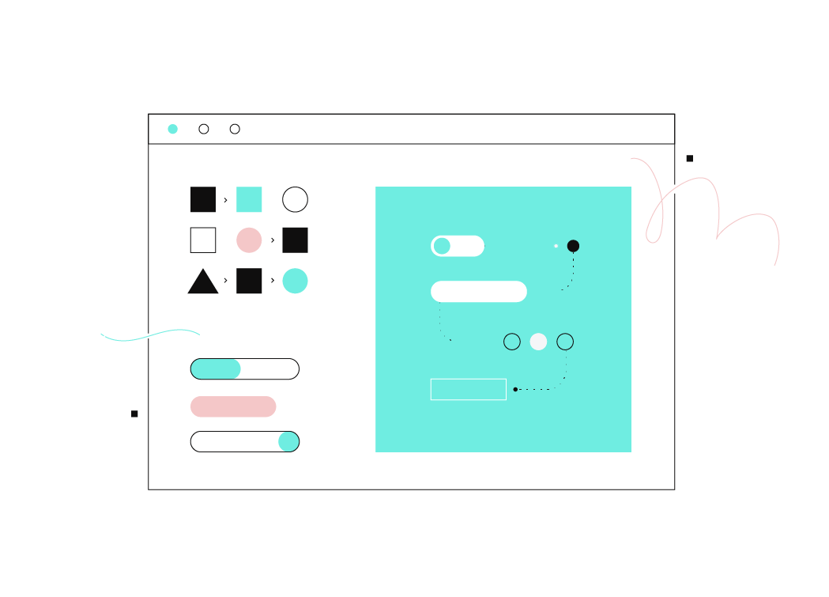
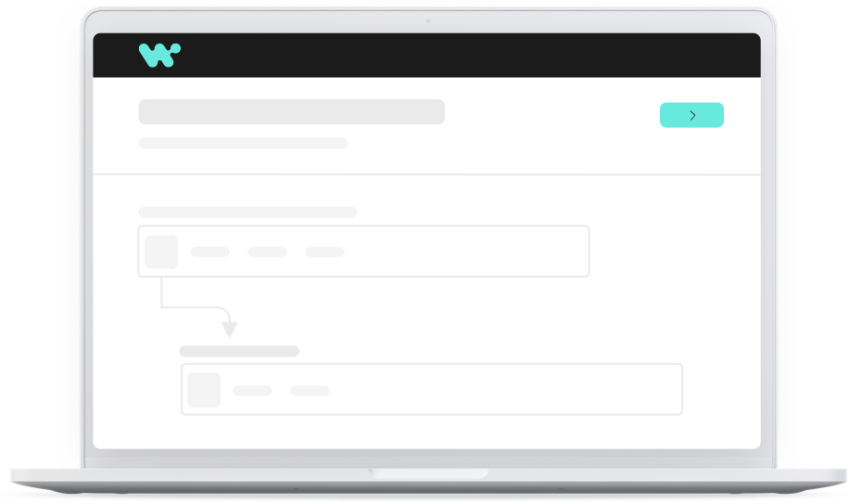
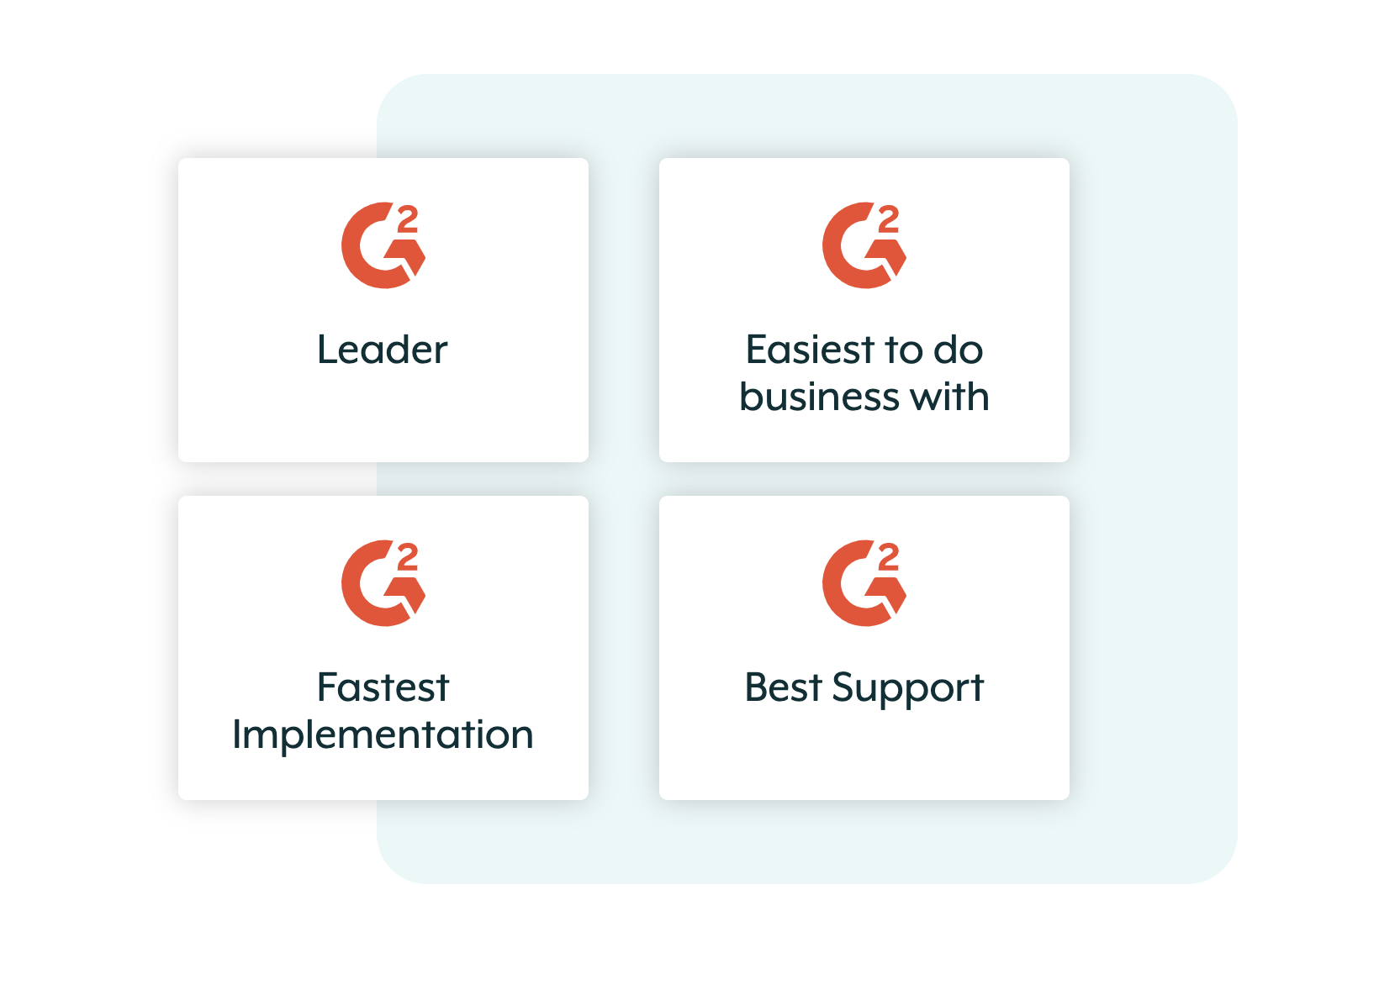
Partner Campaign
Webinar (live then on –demand)
Blogs
Social video
Ebooks
Sales emails
Roadshow
PR
Whitepaper : POV
Notes:
Campaign Concept: “Intelligent Automation in Banking – Executive Roundtable Series”
We propose a co-hosted flagship event that can double as content for wider campaigns. For example, a virtual executive roundtable or panel webinar:
Format: A live webinar (60-minute) featuring a panel: a Deloitte banking practice leader (discussing industry trends), a Workato product evangelist, and ideally a mutual customer (or a Deloitte subject matter expert playing the role of a customer case study).
Topic: “Accelerating Digital Banking with Automation: Trends, Use Cases, and Success Stories.” This hits thought leadership (trends) and practical insights (use cases).
Discussion Points: The panel would cover current challenges banks face (from Deloitte’s viewpoint), how automation is addressing these (Workato’s viewpoint, citing our use cases like onboarding and loan processing), and a real example – e.g. “How Bank X reduced onboarding time by 70% using intelligent automation” (with specifics to make it tangible).
Audience: Banking IT leaders, operations executives, and innovation heads. We’d invite prospects from our pipeline, Deloitte’s client list, and promote via LinkedIn and industry groups.
Promotion: Leading up to the event, we’d run a joint campaign – emails from Deloitte to their contacts and from Workato to ours, social media posts (with both companies amplifying), and perhaps a press release or LinkedIn article by an executive from each side about our partnership in banking.
Value-add: To encourage attendance, we could offer an exclusive whitepaper (co-branded) like “The Connected Bank: A Blueprint for End-to-End Automation”, available to attendees. This whitepaper would contain the distilled insights and perhaps the frameworks (like the 3 use cases) we discussed, providing take-home value.
Event Execution: During the webinar, we ensure strong branding for both Workato and Deloitte. The joint positioning statement is reiterated by the moderator. Deloitte sets context with industry stats (showcasing thought leadership), Workato demonstrates one of the use cases (perhaps even a quick demo of an automation if feasible, such as showing a Workato recipe handling a sample onboarding scenario). The session ends with a Q&A and a call-to-action for viewers: e.g. “Contact us for a Banking Automation Assessment” – a workshop offering by Deloitte+Workato to analyze the attendee’s own processes.
Follow-up Campaign: After the event, the content can be repurposed:
A blog summary of the discussion on Workato’s site and Deloitte’s blog.
The recording gated on our websites for lead capture (top-of-funnel content).
Sales teams follow up with their invitees with a tailored message and the whitepaper.
Possibly an in-person follow-up: using the momentum, plan a small dinner event at a Banking conference (with both Deloitte and Workato reps) to continue the conversation with select prospects.

Slide 18
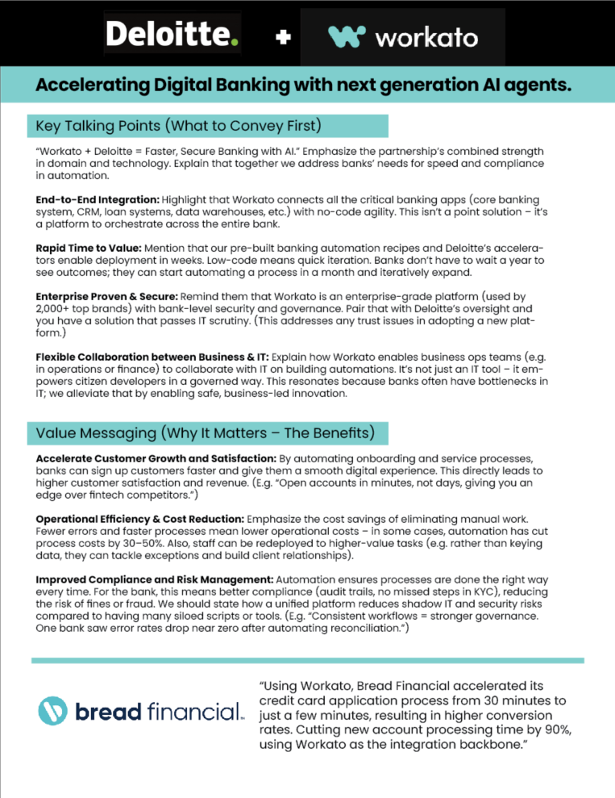
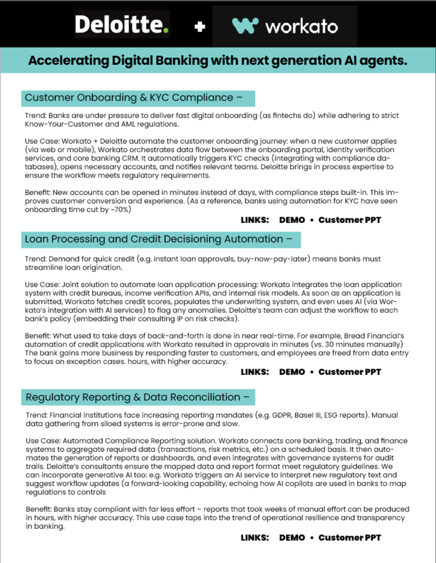
Sales enablement
emails
Video training
One pagers
Notes:
Campaign sales enablement

Slide 19
Thank you

